Slide 1
Topological Sort

Slide 2
Topological Sort
Sorting technique over DAGs (Directed Acyclic Graphs)
It creates a linear sequence (ordering) for the nodes such that:
  If u has an outgoing edge to v ➔ then u must finish before v starts
Very common for ordering of jobs or tasks

Slide 3
Topological Sort Example
A job consists of 10 tasks with the following precedence rules:
Must start with 7, 5, 4 or 9.
Task 1 must follow 7.
Tasks 3 & 6 must follow both 7 & 5.
8 must follow 6 & 4.
2 must follow 4.
10 must follow 2.
Make a directed graph and then do DFS.

Slide 4
9
Tasks shown as a directed graph.
1
7
A job consists of 10 tasks with the following precedence rules:
Must start with 7, 5, 4 or 9.
Task 1 must follow 7.
Tasks 3 & 6 must follow both 7 & 5.
8 must follow 6 & 4.
2 must follow 4.
10 must follow 2.
3
8
5
6
4
10
2

Slide 5
Topological Sort using DFS
To create a topological sort from a DAG
  1- Final linked list is empty
  2- Run DFS
  3- When a node becomes black (finishes) insert it to the top of a
  linked list

Slide 6
Example
9
1
7
3
8
5
6
4
10
2

Slide 7
Example
9
1
7
3
8
5
6
4
10
2

Slide 8
Example
9
1
7
3
8
5
6
4
10
2

Slide 9
Example
9
1
7
3
8
5
6
4
10
2

Slide 10
Example
head
9
1
10
7
3
8
5
6
4
10
2

Slide 11
Example
head
9
1
2, 10
7
3
8
5
6
4
10
2

Slide 12
Example
head
9
1
2, 10
7
3
8
5
6
4
10
2

Slide 13
Example
head
9
1
8, 2, 10
7
3
8
5
6
4
10
2

Slide 14
Example
head
9
1
4, 8, 2, 10
7
3
8
5
6
4
10
2

Slide 15
Example
head
9
1
4, 8, 2, 10
7
3
8
5
6
4
10
2

Slide 16
Example
head
9
1
4, 8, 2, 10
7
3
8
5
6
4
10
2

Slide 17
Example
head
9
1
1, 4, 8, 2, 10
7
3
8
5
6
4
10
2

Slide 18
Example
head
9
1
1, 4, 8, 2, 10
7
3
8
5
6
4
10
2

Slide 19
Example
head
9
1
3, 1, 4, 8, 2, 10
7
3
8
5
6
4
10
2

Slide 20
Example
head
9
1
3, 1, 4, 8, 2, 10
7
3
8
5
6
4
10
2

Slide 21
Example
head
9
1
6, 3, 1, 4, 8, 2, 10
7
3
8
5
6
4
10
2

Slide 22
Example
head
9
1
7, 6, 3, 1, 4, 8, 2, 10
7
3
8
5
6
4
10
2

Slide 23
Example
head
9
1
7, 6, 3, 1, 4, 8, 2, 10
7
3
8
5
6
4
10
2

Slide 24
Example
head
9
1
9, 7, 6, 3, 1, 4, 8, 2, 10
7
3
8
5
6
4
10
2

Slide 25
Example
head
9
1
9, 7, 6, 3, 1, 4, 8, 2, 10
7
3
8
5
6
4
10
2

Slide 26
Example
head
9
1
5, 9, 7, 6, 3, 1, 4, 8, 2, 10
7
3
8
5
6
4
10
2

Slide 27
Topological Sort: Summary
head
9
1
5, 9, 7, 6, 3, 1, 4, 8, 2, 10
7
3
The final order or jobs
8
5
6
Time complexity = DFS complexity O(V + E)
4
There can be many orders that meet the requirements
10
2

Slide 28
Perform TopologicalSorting(Graph)
Input − The given directed acyclic graph.
Output − Sequence of nodes.
Begin
initially mark all nodes as unvisited
for all nodes v of the graph, do
if v is not visited, then
topoSort(i, visited, stack)
done
pop and print all elements from the stack
End.

Slide 29
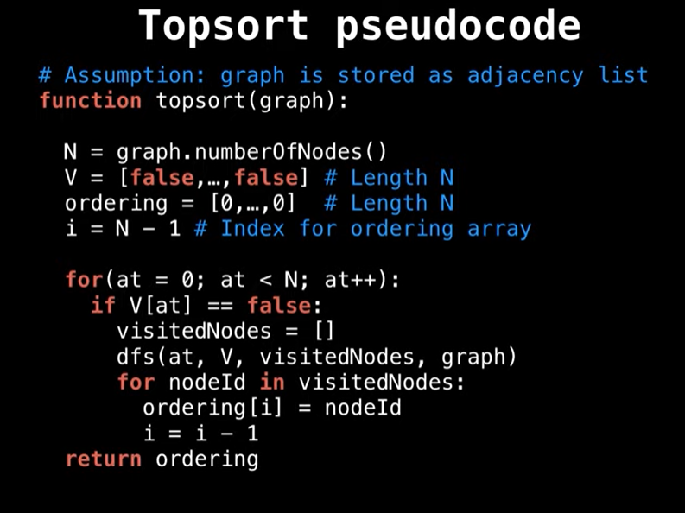

Slide 30
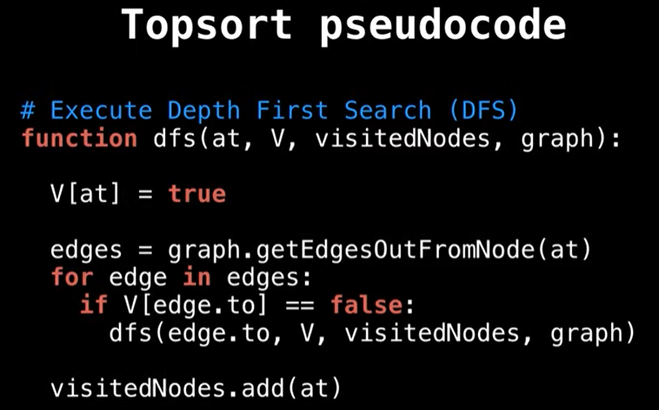

Slide 31
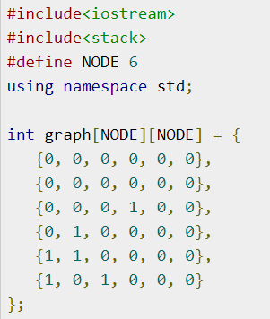
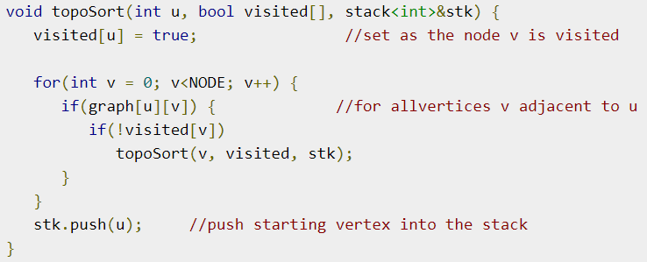
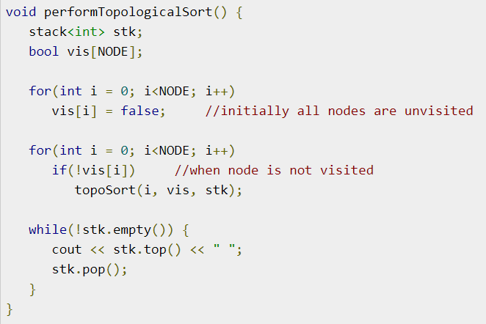
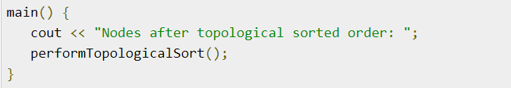

Slide 32
#include<stdio.h>
#define MAX 200
int n,adj[MAX][MAX];
int front = -1,rear = -1,queue[MAX];
void main() {
int i,j = 0,k;
int topsort[MAX],indeg[MAX];
create_graph();
printf(“The adjacency matrix is:\n”);
display();
for (i=1;i<+n;i++) {
indeg[i]=indegree(i);
if(indeg[i]==0)
insert_queue(i);
}
while(front<=rear) {
k=delete_queue();
topsort[j++]=k;
for (i=1;i<=n;i++) {
if(adj[k][i]==1) {
adj[k][i]=0;
indeg[i]=indeg[i]-1;
if(indeg[i]==0)
insert_queue(i);
}
}
}
printf("Nodes after topological sorting are:\n");
for (i=0;i<=n;i++)
printf("%d",topsort[i]);
printf("\n");
}
create_graph() {
int i,max_edges,origin,destin;
printf("\n Enter number of vertices:");
scamf("%d",&n);
max_edges = n * (n - 1);
for (i = 1;i <= max_edges;i++) {
printf("\n Enter edge %d (00 to quit):",i);
scanf("%d%d",&origin,&destin);
if((origin == 0) && (destin == 0)) {
printf("Invalid edge!!\n");
i–;
} else
adj[origin][destin] = 1;
}
return;
}
display() {
int i,j;
for (i = 0;i <= n;i++) {
for (j = 1;jrear) {
printf(“Queue Underflow”);
return;
} else {
del_item = queue[front];
front = front + 1;
return del_item;
}
}
int indegree(int node) {
int i,in_deg = 0;
for (i = 1;i <= n;i++)
if(adj[i][node] == 1)
in_deg++;
returnin_deg;
}

